Slide 1

VACILANDO -A Travelling Guide
SHRI VISHNU ENGINEERING COLLEGE FOR WOMEN(AUTONOMOUS) :: BHIMAVARAM
DEPARTMENT OF COMPUTER SCIENCE & ENGINEERING
MINI PROJECT
Guide : Dr K. Ramachandra Rao
Team Members : 21B01A0569
21B01A0579
21B01A0598
21B01A05B8
21B01A05C0

Slide 2
ABSTRACT
“Travelling” the word itself has a very popular fan base. It helps us to explore different places and also explore ourselves. Our idea is to make a platform which helps all the people who are interested in travelling. By this application we can choose our desired place for a vacation or a trip. And this application contains a blog where the customers of our application share their beautiful experiences with others so that others can have a brief note about the facilities. And we can also have Chat Group to maintain interaction between the travellers.

Slide 3
OVERVIEW
Our Travel Guide Website is a one-stop platform for all your travel needs.
Whether you are planning a vacation, seeking destination recommendations, or looking to connect with fellow travelers, our website has got you covered.
FEATURES
Explore Destinations: Discover popular travel destinations based on season and state selection.
Login and Signup: Create an account or log in to access personalized features.
Group Chat: Engage with a community of travelers, join chat rooms, and share experiences.
Blogs: Share your travel stories, upload photos, and connect with like-minded individuals.

Slide 4
AGENDA
Problem Statement: Finding a perfect spot, time for Vacation.
Solution Overview: Introducing our Travel Guide Website.
User Interface: Showcasing the intuitive design and user experience.
Explore Destinations: Browsing and discovering destinations based on season and state.
5.Login and Signup: Secure authentication and user registration process.
6.Group Chat: Interacting with a community of travelers.
7.Blogs: Sharing travel experiences and insights.
8.Admin Dashboard: Optional module for website management.
9.Technology Stack: Overview of the technologies used in development.
10.Conclusion: Recap of key points and benefits.

Slide 5
CHALLENGES FACED BY TRAVELERS
Planning a trip can be exhausting and time-consuming.
Travelers often struggle to find reliable and up-to-date information on destinations, especially during specific seasons.
Connecting with other travelers and seeking personalized recommendations can be challenging.
Information Overload: It's difficult to filter through the noise and find trustworthy information over the Internet.
Seasonal Considerations: Travelers may have specific preferences for certain seasons or weather conditions, but finding suitable destinations can be procrastination.
Lack of Community Interaction: Many travelers value connecting with others to exchange tips, ask questions, and share experiences.
OUR SOLUTION
The Travel Guide Website aims to address these challenges by providing a user-friendly platform that destination recommendations, community engagement, and personalized travel experience

Slide 6
KEY FEATURES
Explore Destinations:
Discover popular destinations based on season and state selection.
Get detailed information about attractions, activities, and local recommendations.
Login and Signup:
Create a personal account to access personalized features.
Enjoy a seamless login process and secure authentication powered by Firebase.
Group Chat:
Engage with a community of travelers through group chat functionality.
Join chat rooms, share experiences, and seek travel advice from fellow enthusiasts.
4.Blogs:
1.Share your travel stories, insights, and recommendations with the community.
2.Upload photos, provide tips, and inspire others with your experiences.

Slide 7
Our Technology Stack:
Front-End:
HTML5, CSS3, JavaScript, Bootstrap: Building the user interface and implementing interactive
elements, Developing a responsive and dynamic front-end framework.
Material-UI: Utilizing a modern UI component library for consistent and visually appealing designs.
Back-End:
Firebase: Handling authentication, real-time database, and storage functionalities.
Database:
Firebase Realtime Database: Storing and retrieving data in real-time.
Firebase Storage: Managing file storage for user-generated content.

Slide 8
Next Steps:
Continuous Improvement: We strive to enhance the website based on user feedback and evolving travel trends.
User Engagement: Encourage users to actively participate, contribute, and share their travel experiences.
Expansion and Partnerships: Explore opportunities to collaborate with travel industry partners to provide additional value to our users.
Benefits for Travelers:
Convenient access to reliable and relevant travel information.
Connect and interact with like-minded travelers.
Gain inspiration from real-life travel stories and experiences.
Personalize your travel preferences and create a tailored travel profile.

Slide 9

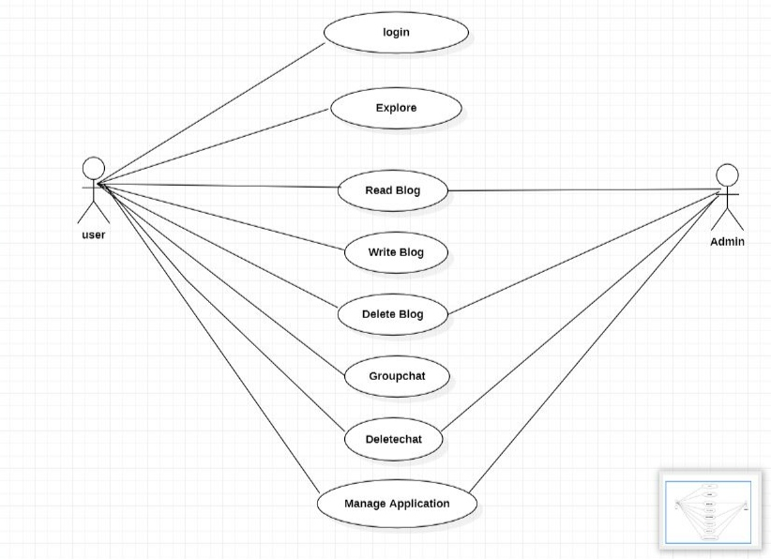
Use Case diagram :

Slide 10
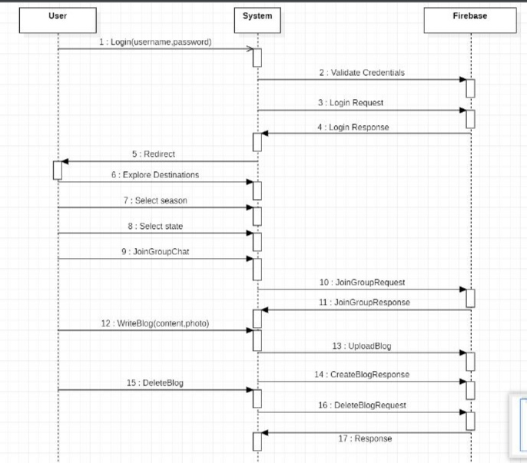
Sequence diagram:

Slide 11
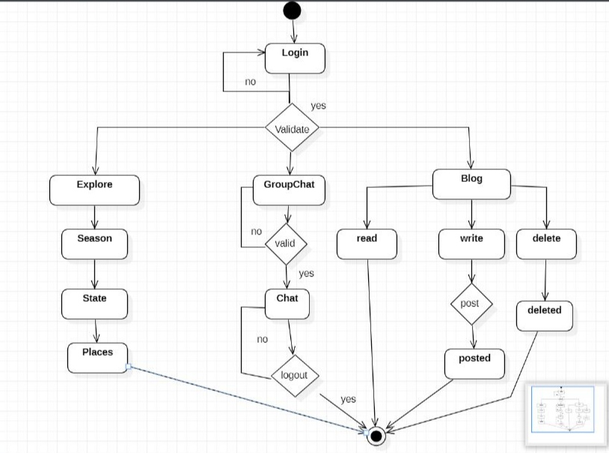
Activity diagram:

Slide 12
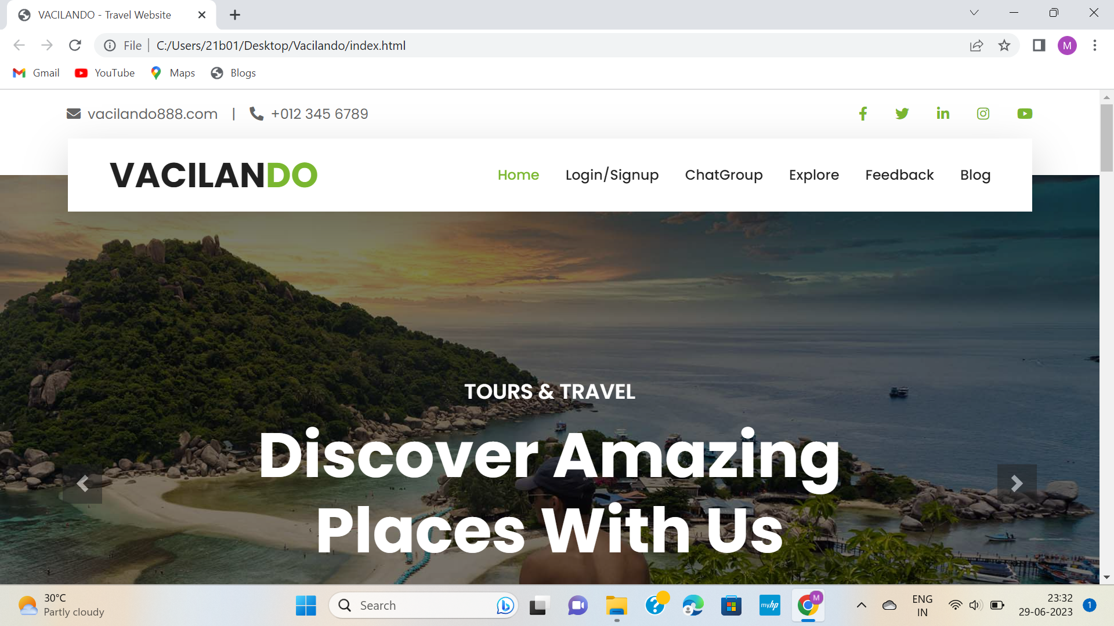
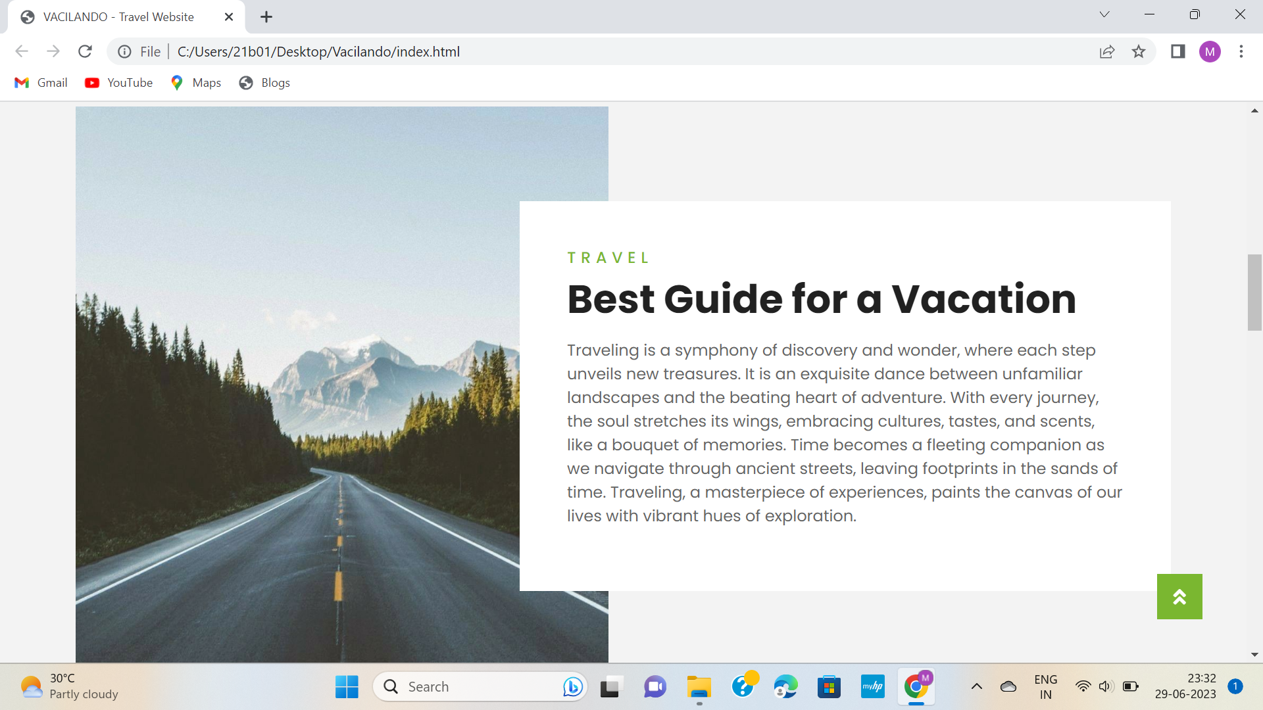
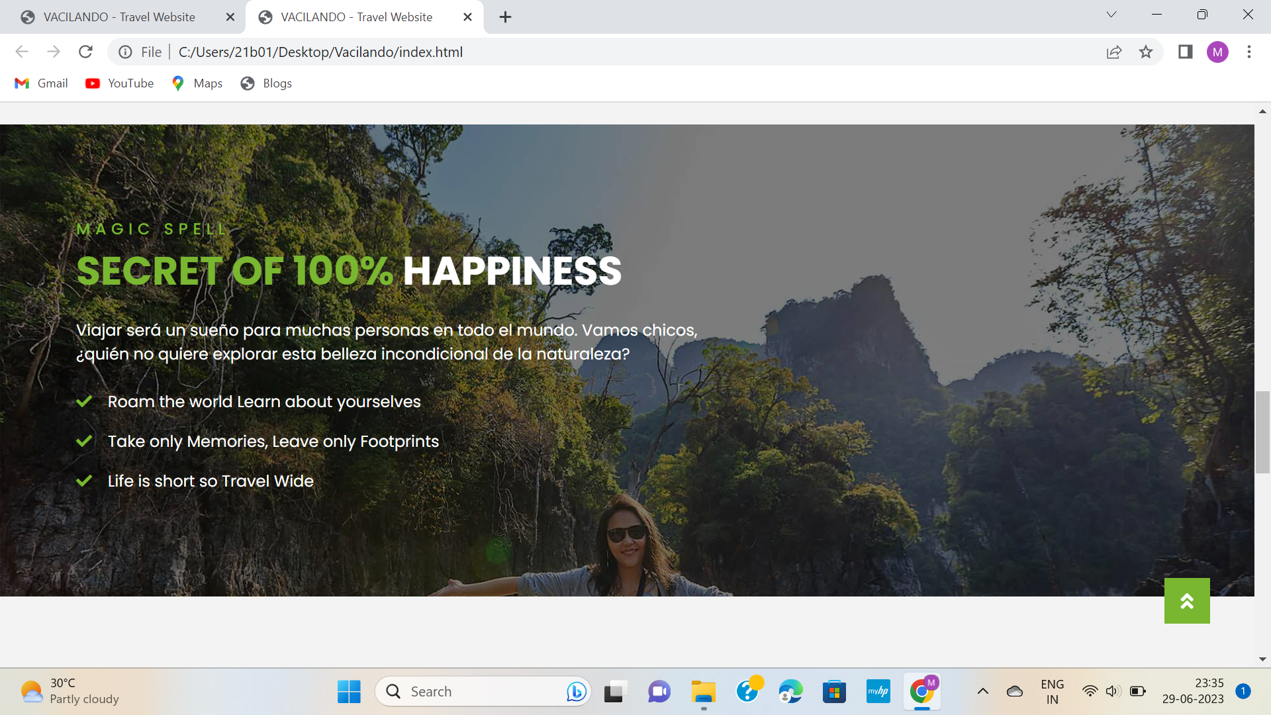
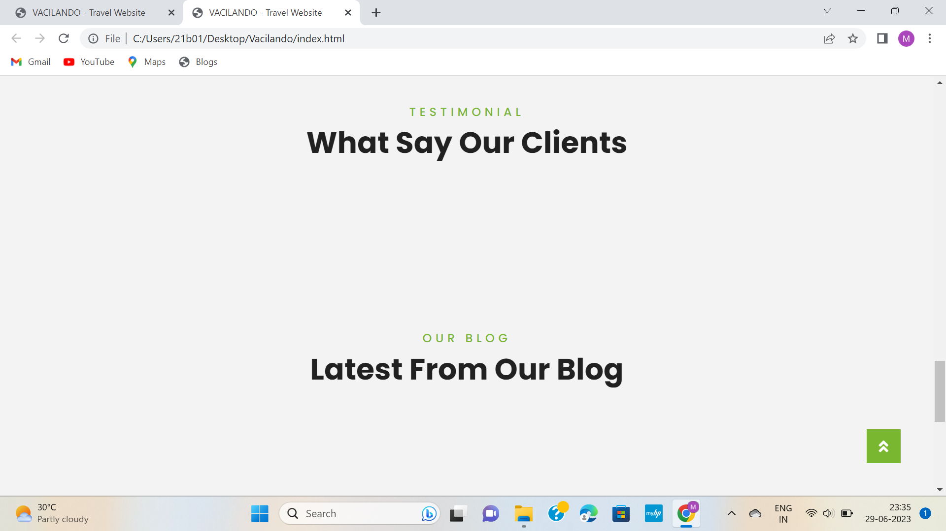

Slide 13
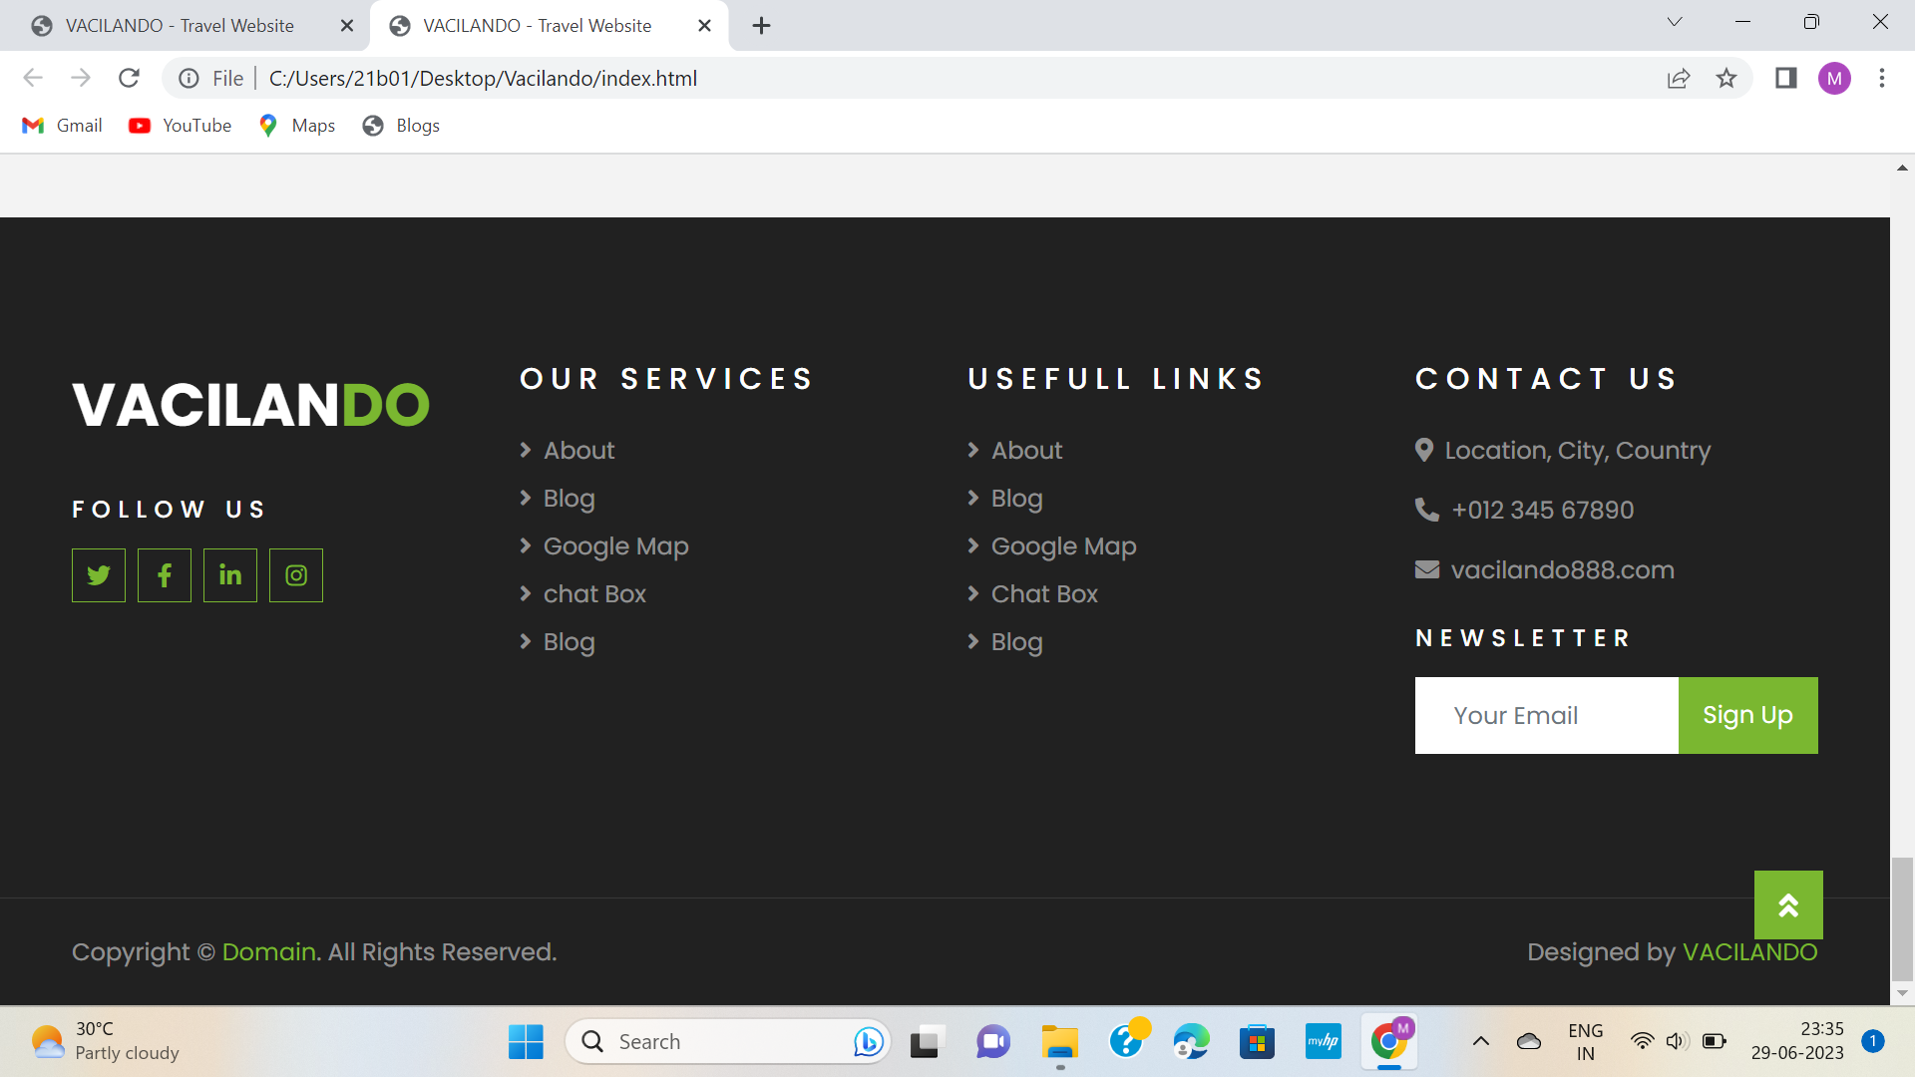
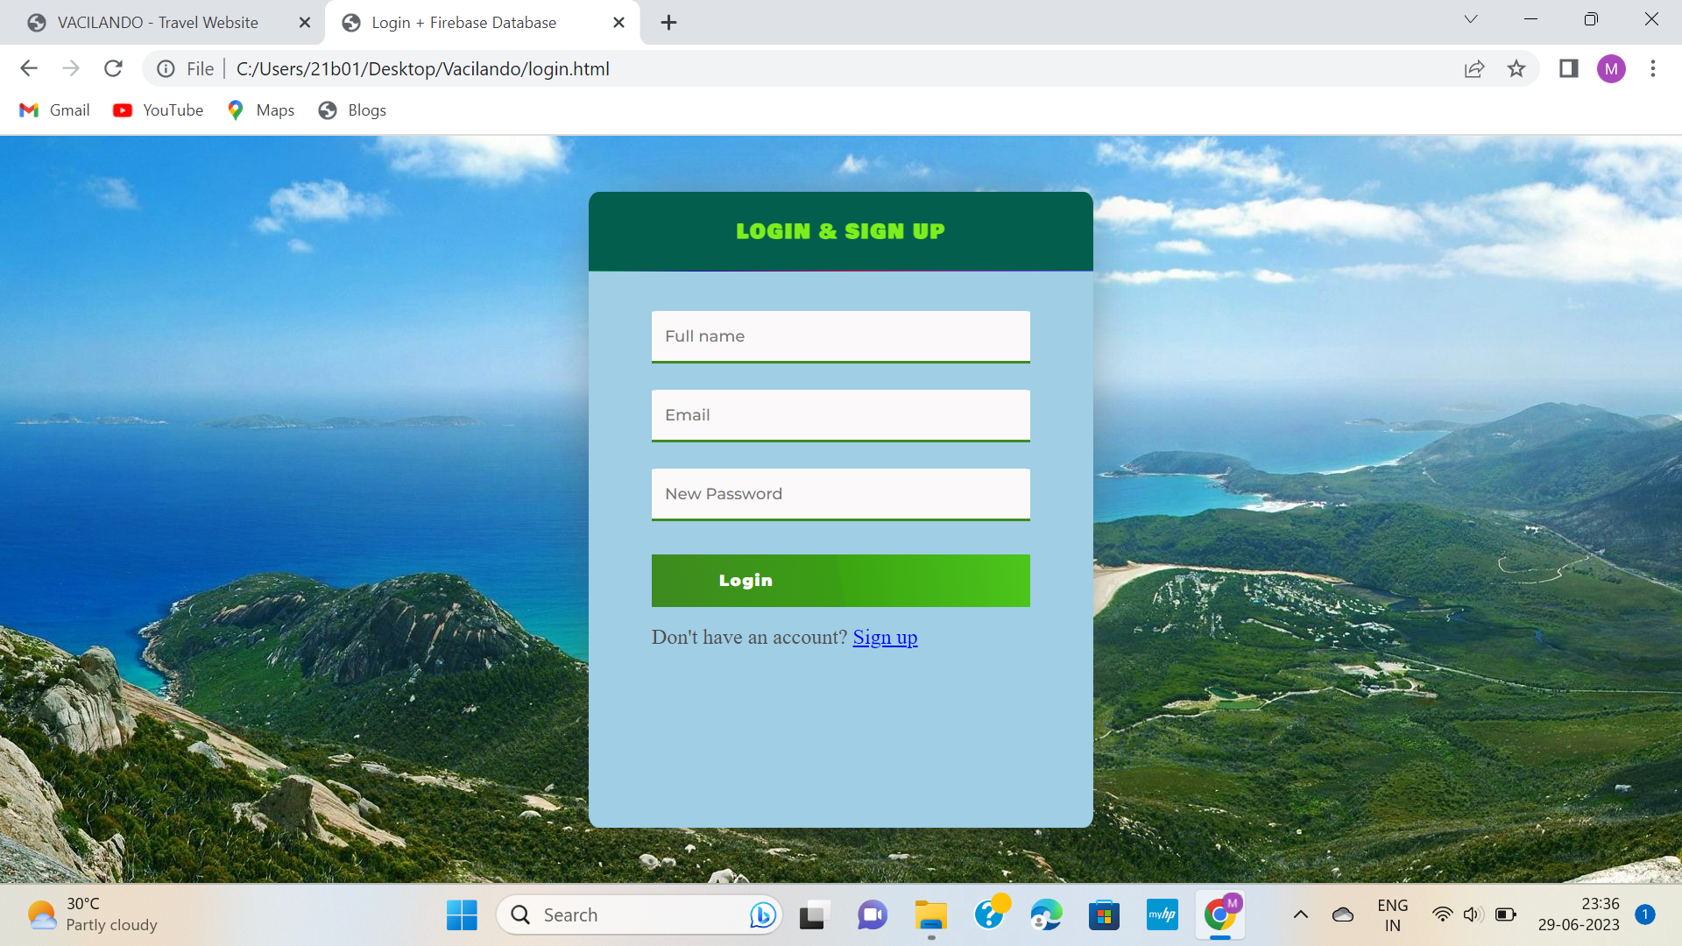
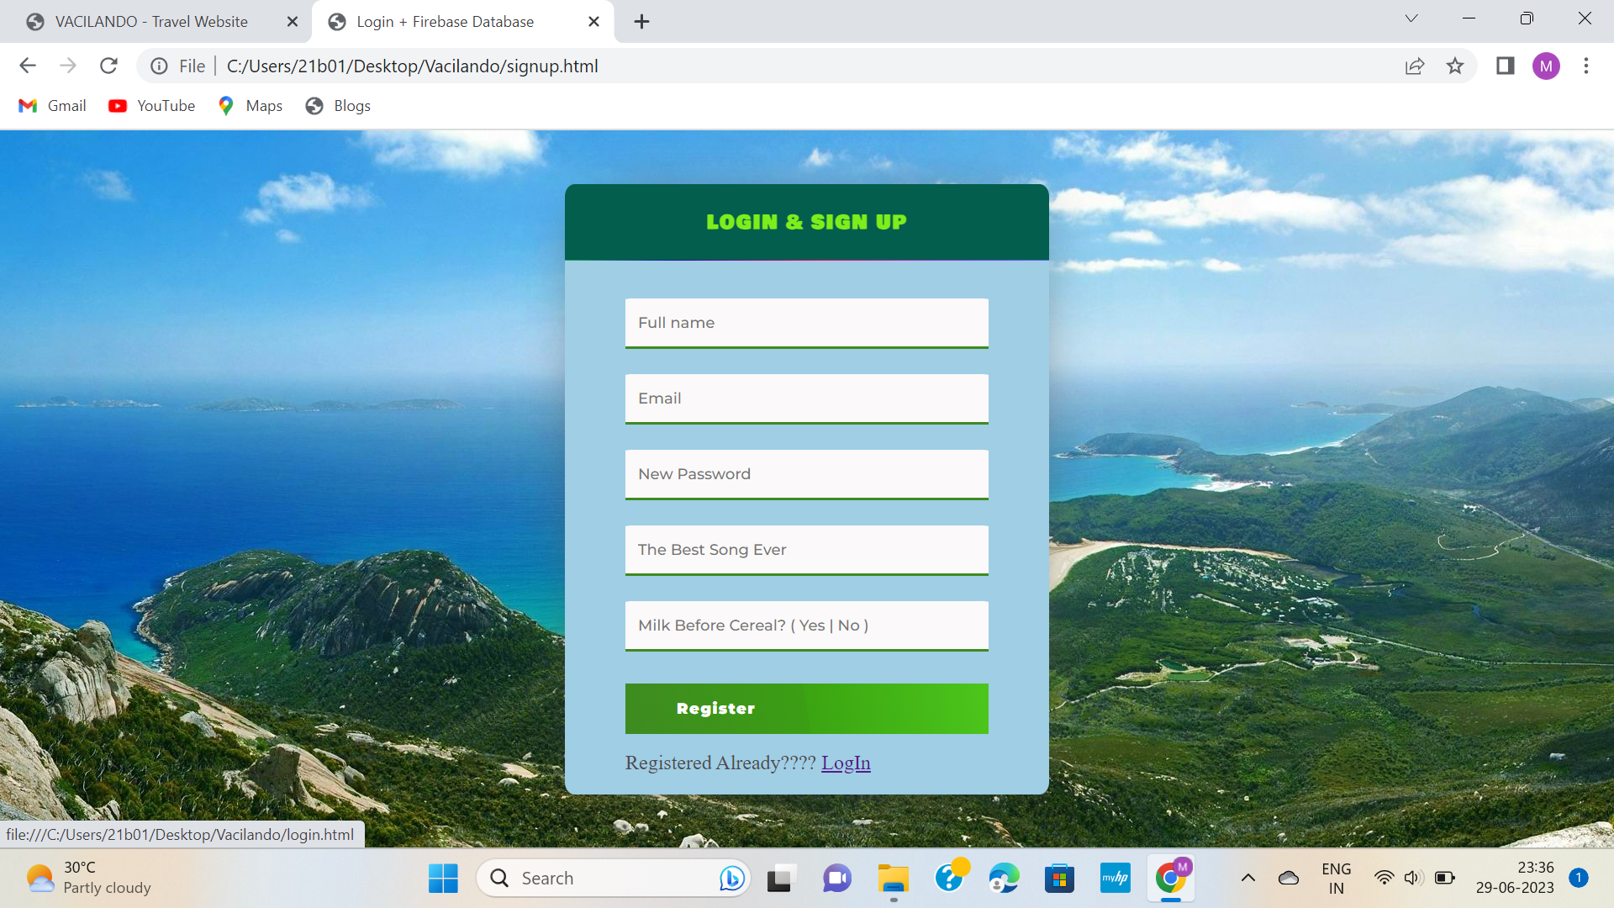

Slide 14
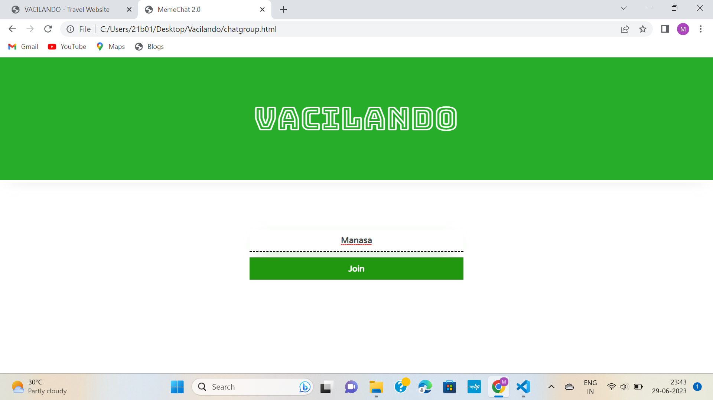
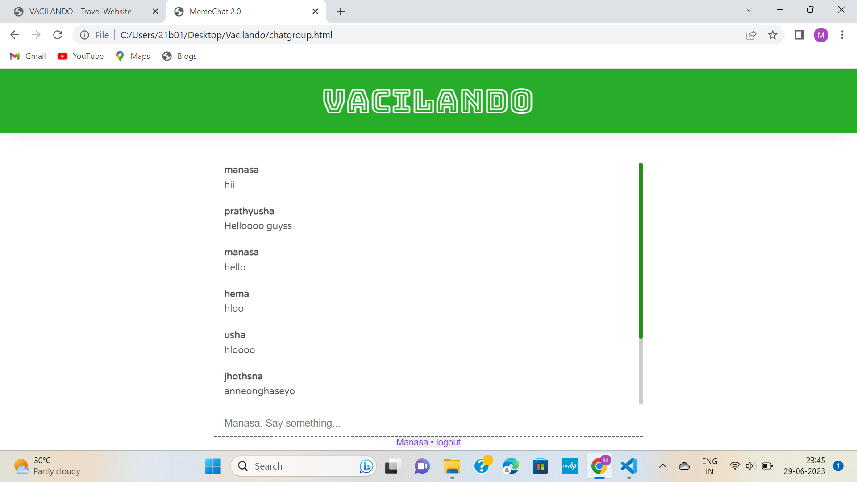
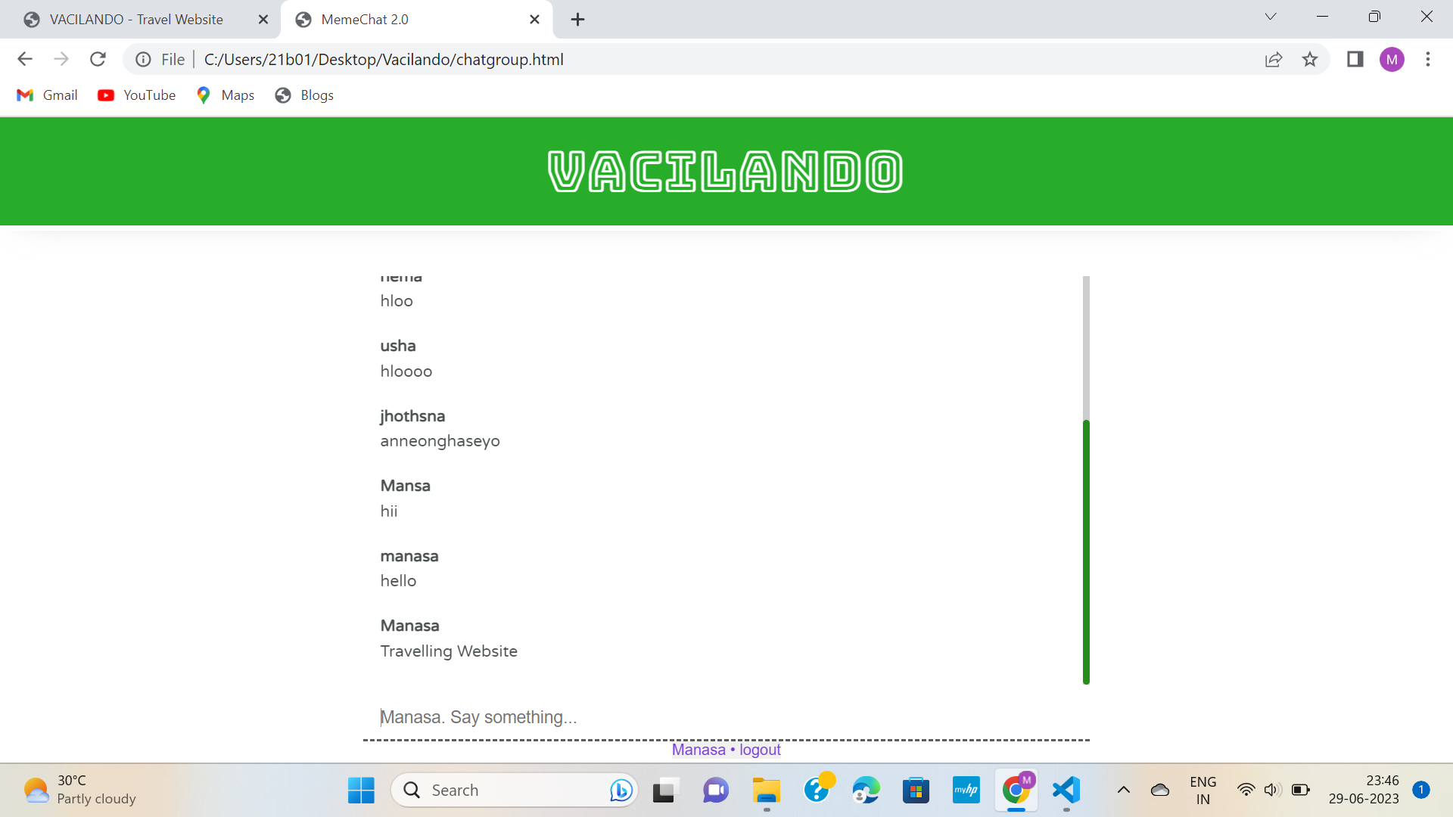

Slide 15
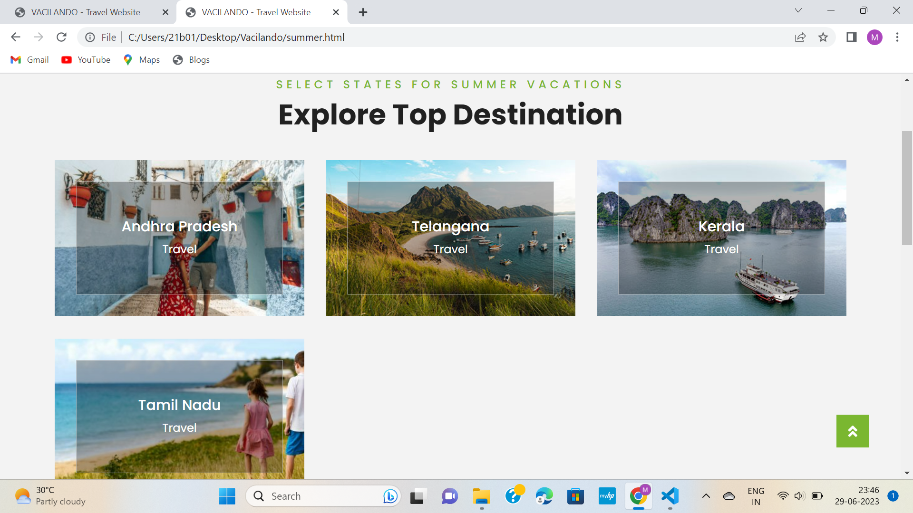
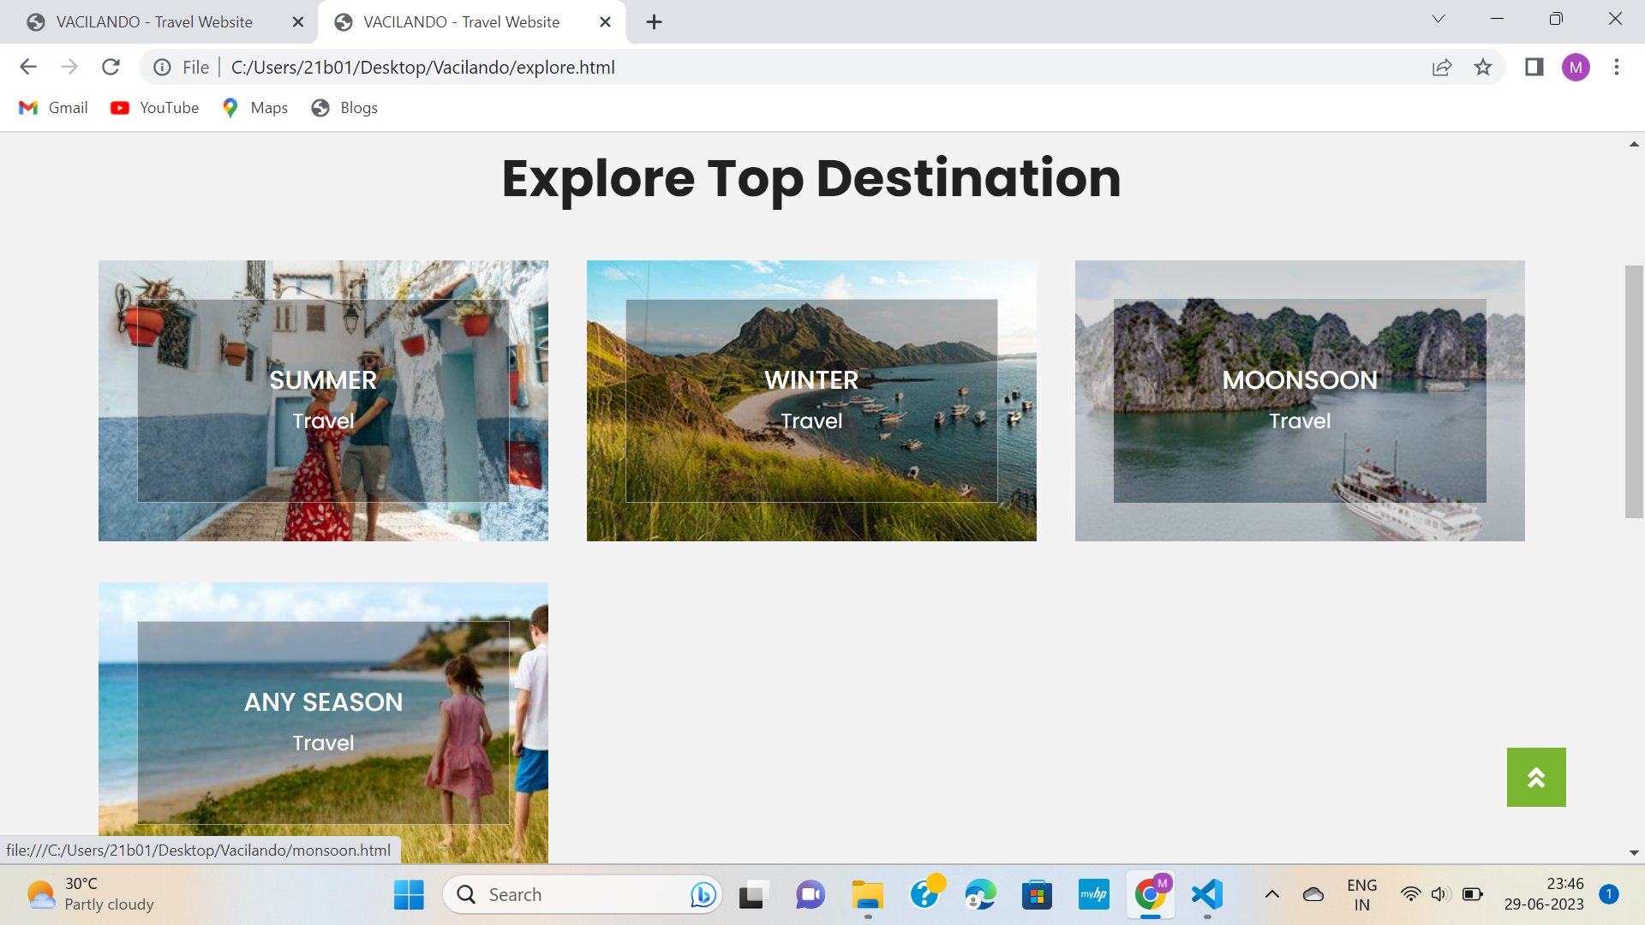

Slide 16
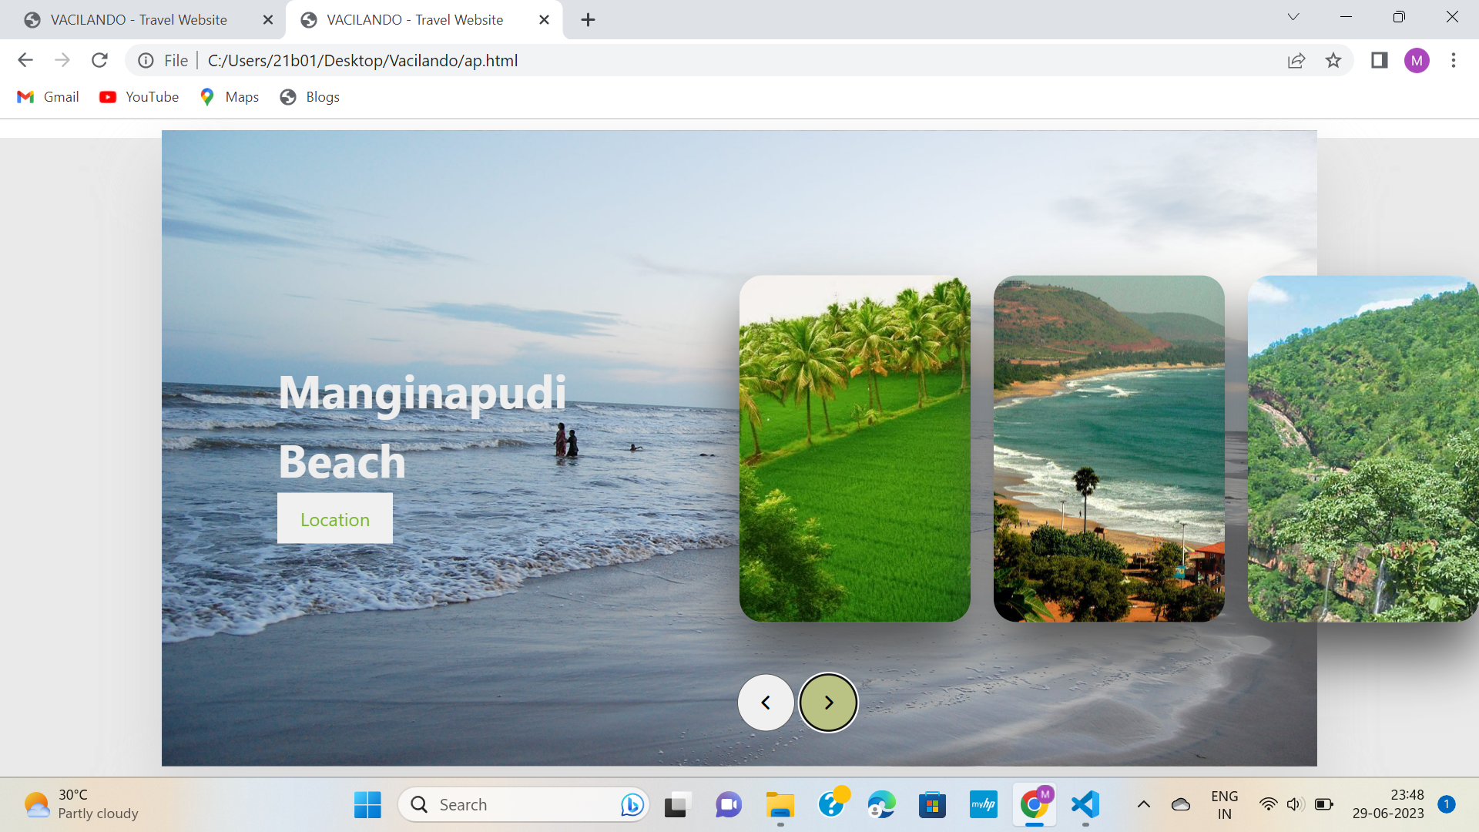

Slide 17
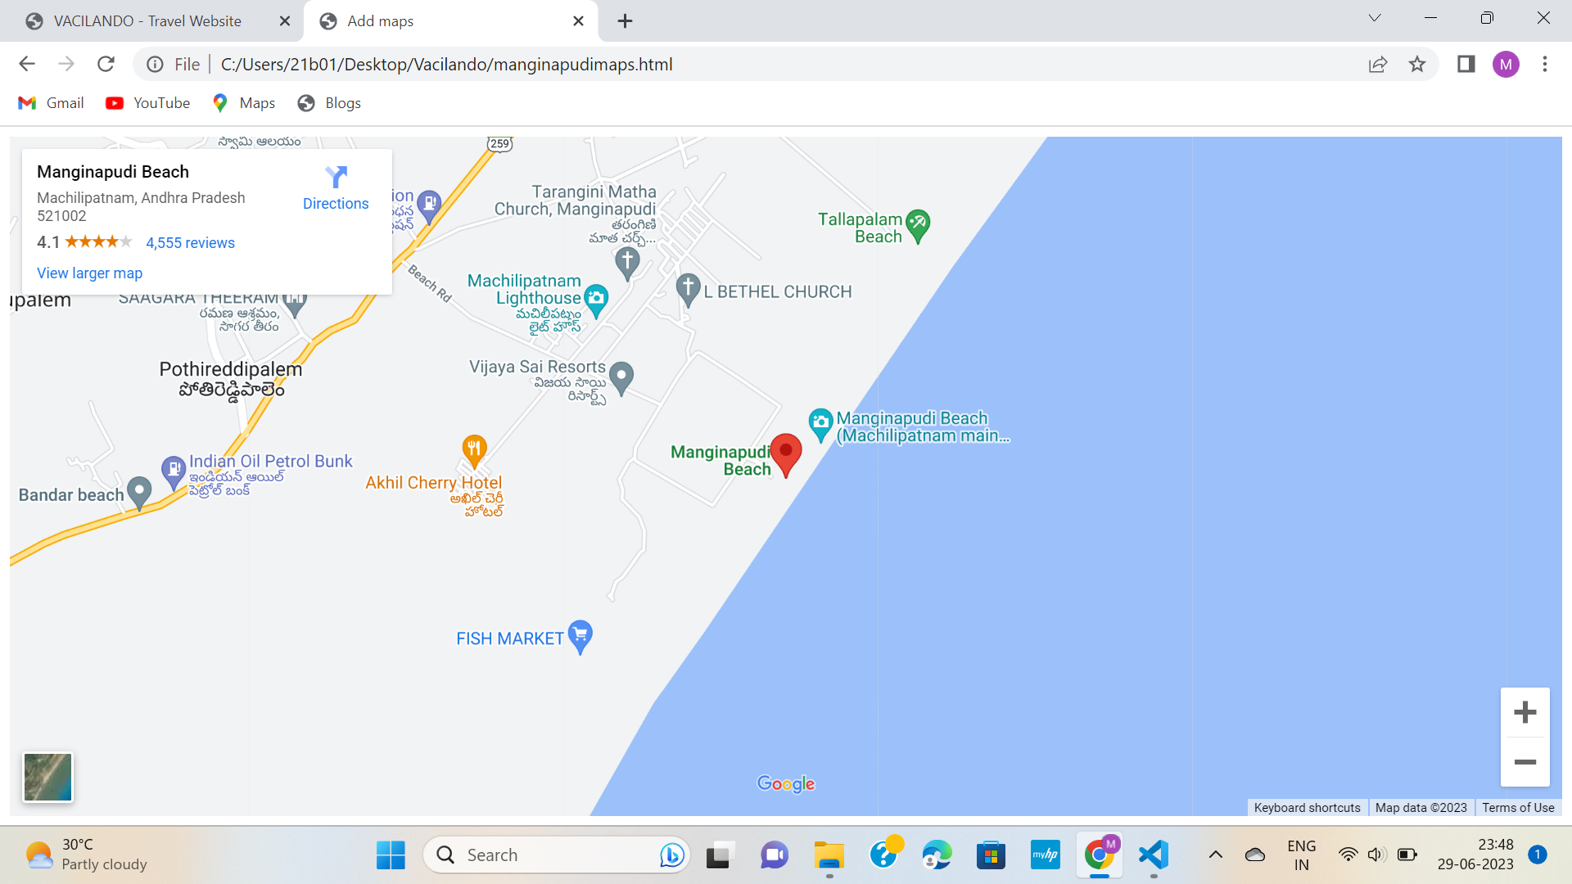

Slide 18
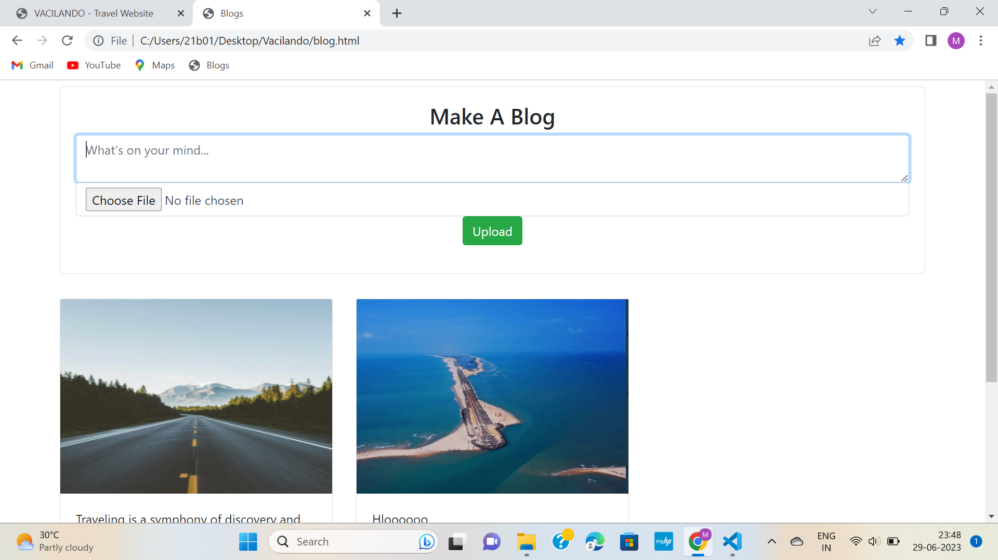

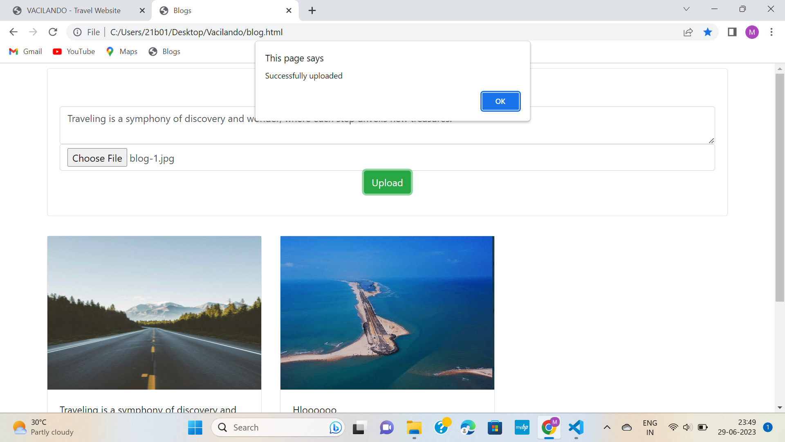

Slide 19
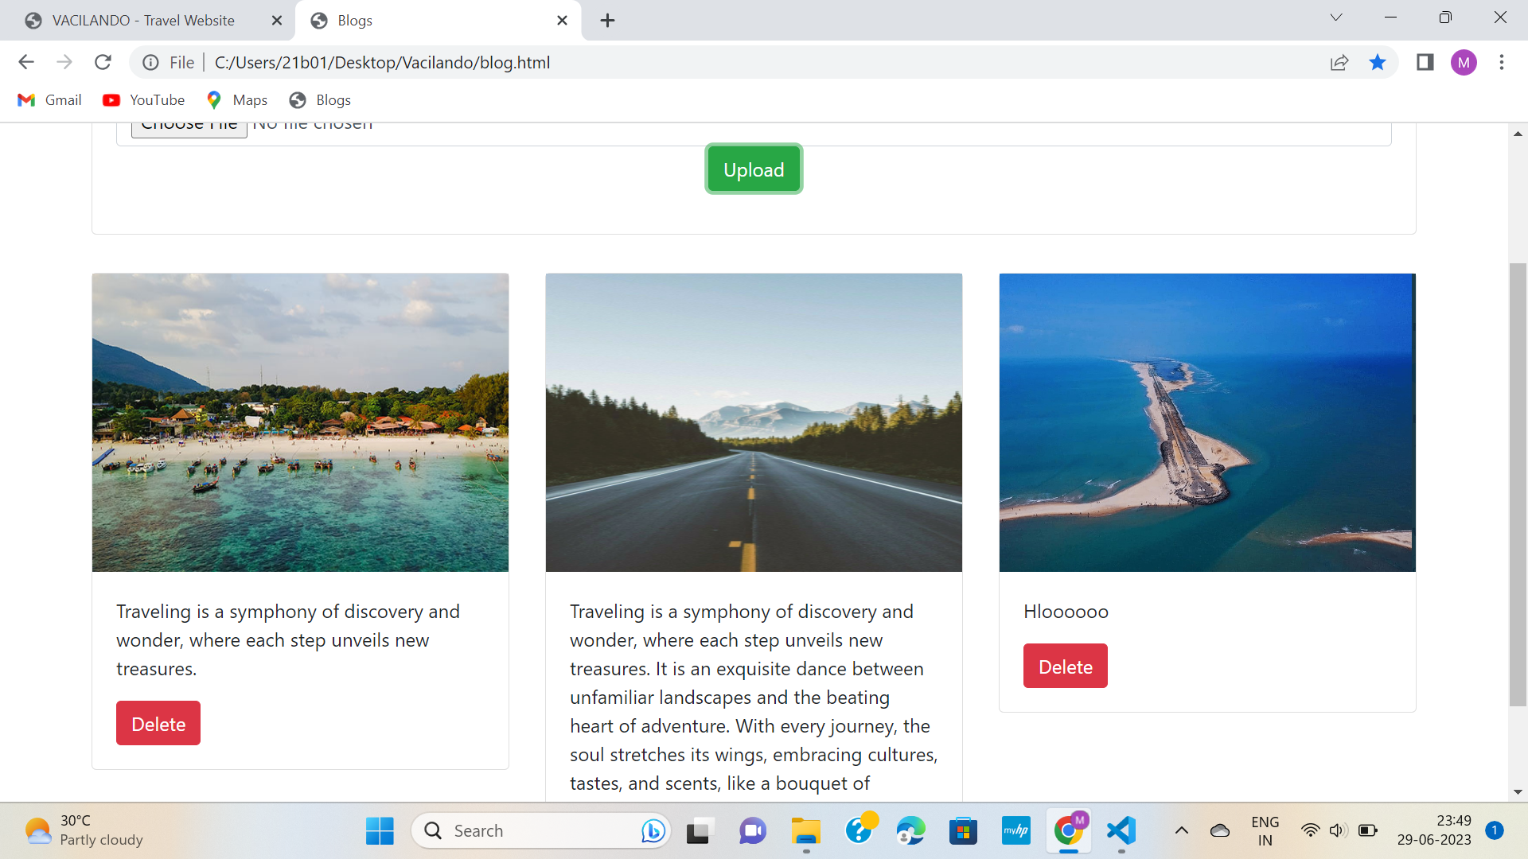

Slide 20
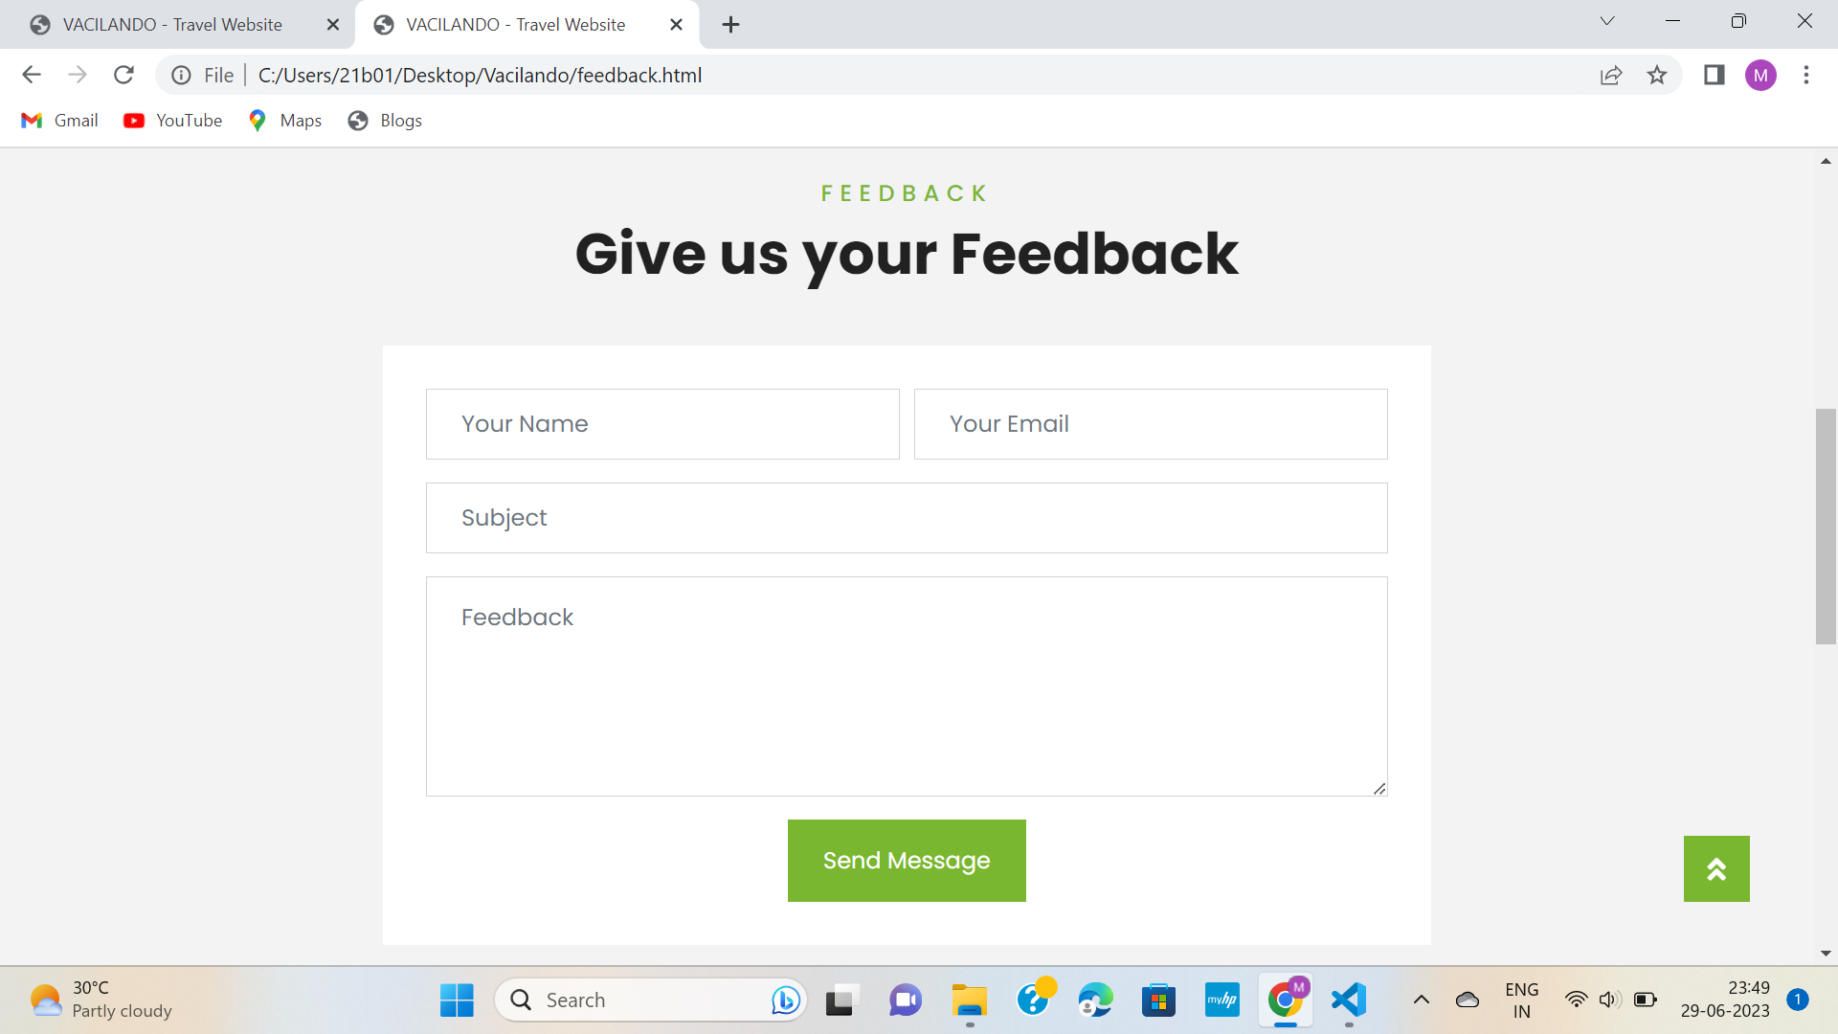

Slide 21
Key Benefits:
Convenient access to reliable and relevant travel information.
Community engagement and networking opportunities with fellow travelers.
Personalized travel experiences based on individual preferences.
Secure authentication and data protection powered by Firebase.
CONCLUSION
Our Travel Guide Website is designed to simplify travel planning and enhance the overall travel experience.
With features such as Explore Destinations, Login and Signup, Group Chat, and Blogs, we provide a comprehensive platform for travelers to connect, share, and explore.

